Slide 1
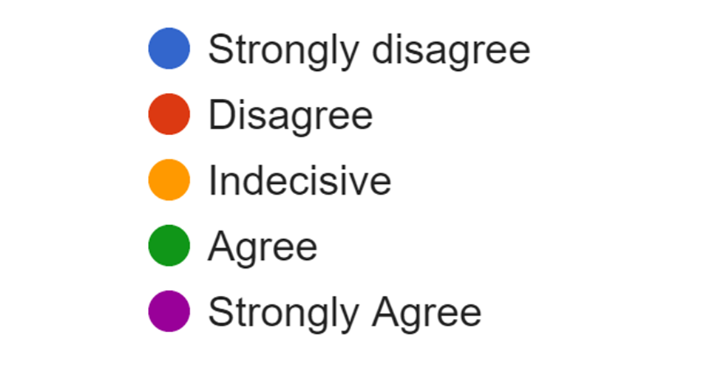
Self-Confidence in Clinical Breast Examination(CBE) Among Students of Bezmialem Vakif University Medical Faculty
Melikcan Şenol¹, Yeliz Emine Ersoy²
1Bezmialem Vakif University, Faculty of Medicine, Istanbul, Turkey
2Bezmialem Vakif University, Faculty of Medicine, Department of General Surgery, Istanbul, Turkey
Introduction
Breast cancer remains a worldwide public health dilemma and is currently the most common tumour in the globe. It is a global issue now, but still it is diagnosed in the advanced stages due to the negligence of women regarding the self inspection and clinical examination of the breast. Early diagnosis of breast cancer is one of the best approaches to prevent the devastating consequences of this disease. In some developed countries, the 5-year relative survival rate of breast cancer patients is above 80% due to early prevention. Clinical Breast Examination(CBE) is a key step in the diagnosis and surveillance of a number of benign and malignant breast diseases. When used as part of a multimodal evaluation, the breast exam provides important information used in both the workup and management of many diseases of the breast. The aim of this study is to demonstrate the number of CBEs to improve students' confidence in their CBE skills.
Materials and Methods
An online survey was conducted to Bezmialem Vakıf University Faculty of Medicine’s 4th, 5th and 6th-grade students. 68 female and 33 male students between the ages of 20-25 were included in the study. The students were asked about the number of clinical breast examinations they have done so far. The students were asked how they felt sufficient in clinical breast examination. The students were asked how well they could distinguish abnormalities in clinical breast examination. The students were asked how many times clinical breast examination should be practiced. They were asked to answer the questions as strongly agree / agree / indecisive / disagree / strongly disagree.
Results
22, 68, and 11 medical faculty students from 4th, 5th and 6th grade, respectively, participated in the study. The number of CBEs performed by the students so far was divided into 8 groups as 1-2, 3-4, 5-6, 7-8, 9-10,11-15,16-20 and 20+, performed by the number of students as 5,13,23,14,4,6,17, respectively. Among the students participating in the study, 45,6%(46/101)felt competent, but 38,6% (39/101) felt indecisive in CBE. 60,4% (60/101) thought they could distinguish abnormalities, but 26,7% (27/101) felt indecisive. 55,4% (56/101) of them thought that more than 20 clinical breast examinations should be performed.
Figure1. How many clinical breast examinations have you done so far?
Figure2. I feel competent in clinical breast examination.
Figure3.I can distinguish abnormal masses in clinical breast examination.
Figure4. How many times do you think the clinical breast examination skill should be practiced at least?
Conclusion
This study shows that the more the students perform CBEs, the more they gain confidence in distinguishing lesions, especially after 20 times of through examination.
References
1. Akram M, Iqbal M, Daniyal M, Khan AU. Awareness and current knowledge of breast cancer. Biol Res. 2017 Oct 2;50(1):33.
2. Sun YS, Zhao Z, Yang ZN, Xu F, Lu HJ, Zhu ZY, Shi W, Jiang J, Yao PP, Zhu HP. Risk Factors and Preventions of Breast Cancer. Int J Biol Sci. 2017 Nov 1;13(11):1387-1397.
3. Henderson JA, Duffee D, Ferguson T. Breast Examination Techniques. 2020 Jul 31. In: StatPearls [Internet]. Treasure Island (FL): StatPearls Publishing; 2021 Jan–.
4. Barrett SV, Zapka JG, Mazor KM, Luckmann RS. Assessing third-year medical students' breast cancer screening skills. Acad Med. 2002 Sep;77(9):905-10.
5. Shinnick J, Spelke MB, Martinez AR. Student-Led Training Day Increases Student Confidence in Women's Primary Care Skills. Fam Med. 2016 Jul;48(7):551-5.

